Slide 1
MLDS 2017 Spring
HW4 - Seq2seq & RL
mldsntu2017@gmail.com

Slide 2
Outline
Task Introduction
ChatBot
Dataset
Sequence-to-sequence models for text generation
Demo
RL on Seq2Seq
Format & Submission Rules (next week)
Dataset
Rules & Format
Notes:
===戴===
Introduction
Seq2seq : S2VT
===施&陳===
Training Tips
===棋&袁===
How to reach the baseline?
Format Submission & Rules = testing時間，兩份run.sh格式 , 評分方式（ranking included）, 互評表單連結,禁止使用pre-trained model
===========
我會負責和各位確認報告內容

Slide 3

Task Introduction - ChatBot
Sensible response
Grammar
How are you?
I’m fine, thank you.
Can you help me?
Yes, that’s my pleasure.

Slide 4
Task Introduction - ChatBot
Task-Oriented ChatBot
book tickets,
order meals,
fix bugs,
...
USER

Slide 5
Task Introduction - ChatBot
Open-domain ChatBot
Know everything!
USER

Slide 6
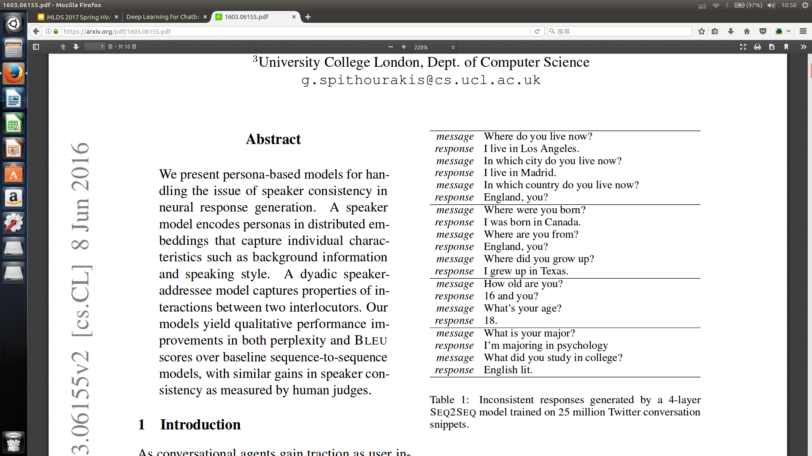
Task Introduction - ChatBot
Multi-turn :
Problem : persona coherence
Open-domain & Single-turn Chatbot for HW4 !

Slide 7
Dataset
Cornell Movie-Dialogs Corpus
OpenSubtitles
Marsan-Ma chat-corpus
others :
chatterbot corpus
CallHome
Whatever you want !

Slide 8
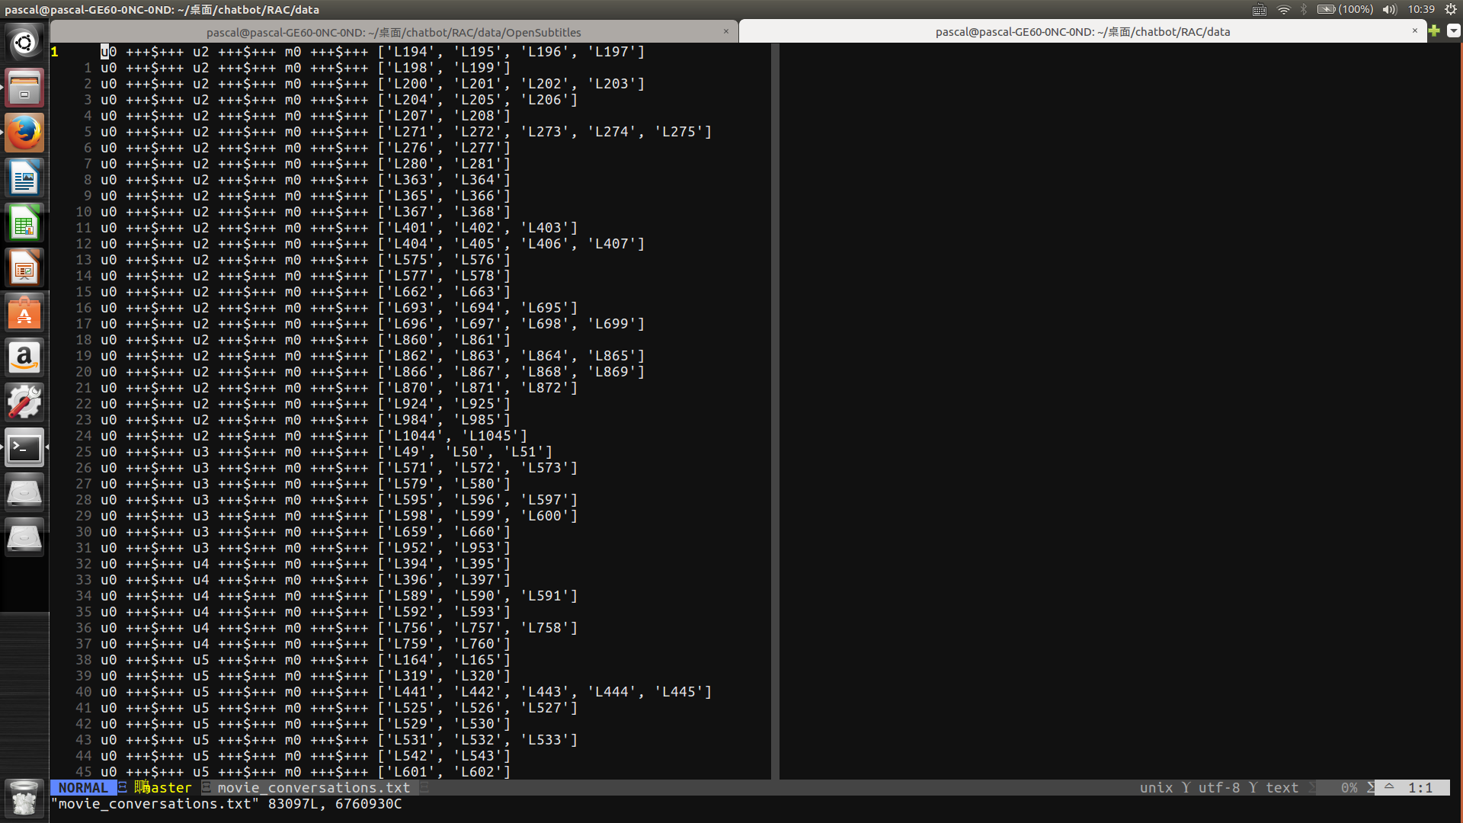
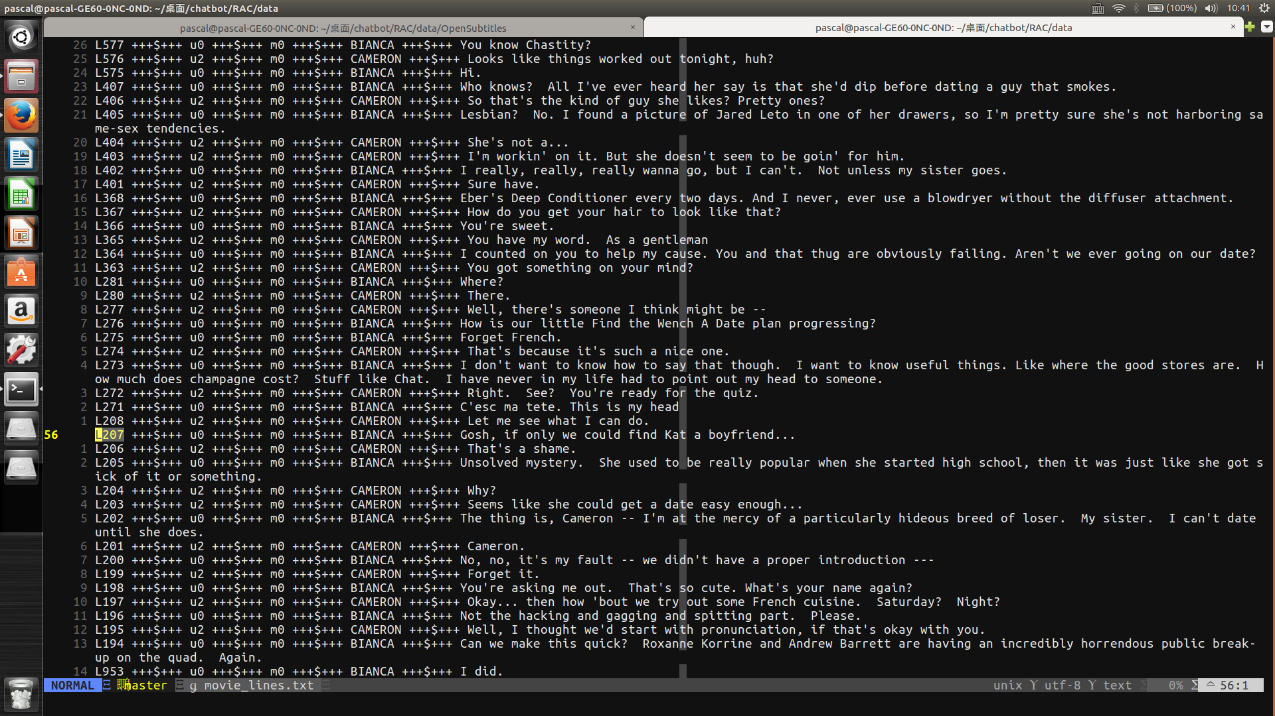
Dataset - Cornell Movie-Dialogs Corpus
movie_conversations.txt
movie_lines.txt

Slide 9
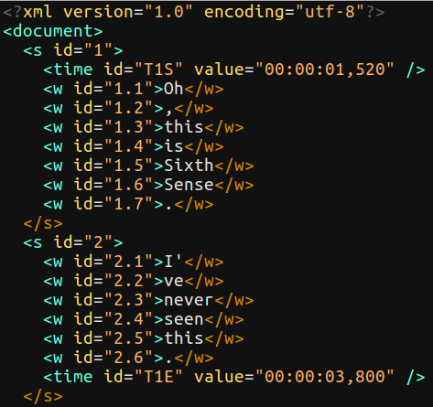
Dataset - OpenSubtitles
Section 4.2 in Vinyals, O., & Le, Q., A neural conversational model

Slide 10
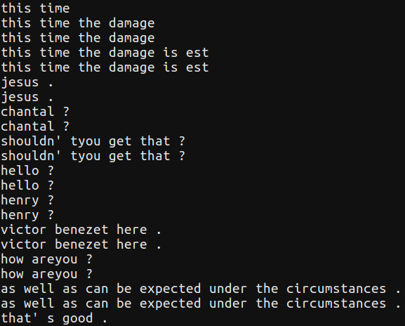
Dataset - Marsan-Ma/ChatCorpus
OpenSubtitle

Slide 11
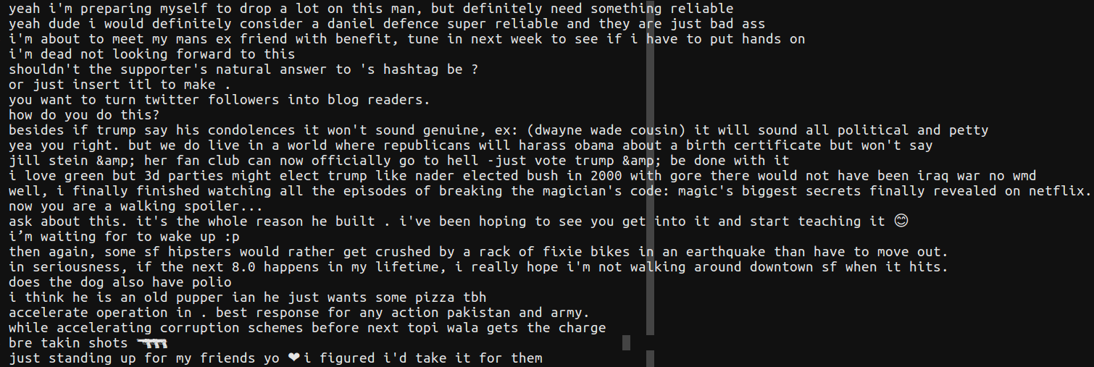
Dataset - Marsan-Ma/ChatCorpus
Twitter_en

Slide 12
Seq2Seq
“Today”
“is”
“very”
“hot”
(Start)
“Today”
“is”
“very”
“How’s”
“The”
“weather”

Slide 13
Seq2Seq for Text Generation
decoder
“Today”
“is”
“very”
“hot”
(Start)
“Today”
“is”
“very”

Slide 14
Cross Entropy Training (XENT)
“Today”
“is”
“very”
“hot”
cross entropy
cross entropy
cross entropy
cross entropy
“Yesterday”
“was”
“so”
“cool”
(Start)
“Today”
“is”
“very”

Slide 15
Issue: Exposure Bias
discrepancy which occurs when a model is only exposed to the training data distribution
“Today”
“was”
“so”
“awesome”
(Start)
“Today”
“was”
“so”

Slide 16
Data As Demonstrator (DAD) / Schedule Sampling
At each time step and with a certain probability, DAD takes as input either the prediction from the model at the previous time step or the ground truth data.
At the beginning, the algorithm always chooses the ground truth words. However, as the training progresses the model predictions are selected more often. This has the effect of making the model somewhat more aware of how it will be used at test time.

Slide 17
Data As Demonstrator (DAD) / Schedule Sampling
“Today”
“is”
“very”
“hot”
cross entropy
cross entropy
cross entropy
cross entropy
“Yesterday”
“was”
“so”
“cool”
(Start)
“Today”
“is”
“very”
p=0.5
p=0.5
p=0.5
“so”
“Yesterday”
“was”

Slide 18
Issue: Loss Function VS Evaluation Matric
A popular choice is the cross-entropy loss used to maximize the probability of the next correct word. However, the performance of these models is typically evaluated using discrete metrics (ex: BLEU).
Training these models to directly optimize metrics like BLEU is hard because these are not differentiable

Slide 19
Sequence-Level Training with RL
reinforcement learning algorithms sidestep the issues associated with the discrete nature of the optimization by not requiring rewards (or losses) to be differentiable
directly optimizes for the final evaluation metric -> reward
MIXER (Mixed Incremental Cross-Entropy Reinforce)
MLDS Lecture 8
Ranzato, M. A., Chopra, S., Auli, M., & Zaremba, W. (2015). Sequence level training with recurrent neural networks.

Slide 20
DEMO
some problems usually occur in training seq2seq
dummy reply
I am sorry, I don’t know, what do you mean...etc
Using Cornell Movie Corpus

Slide 21
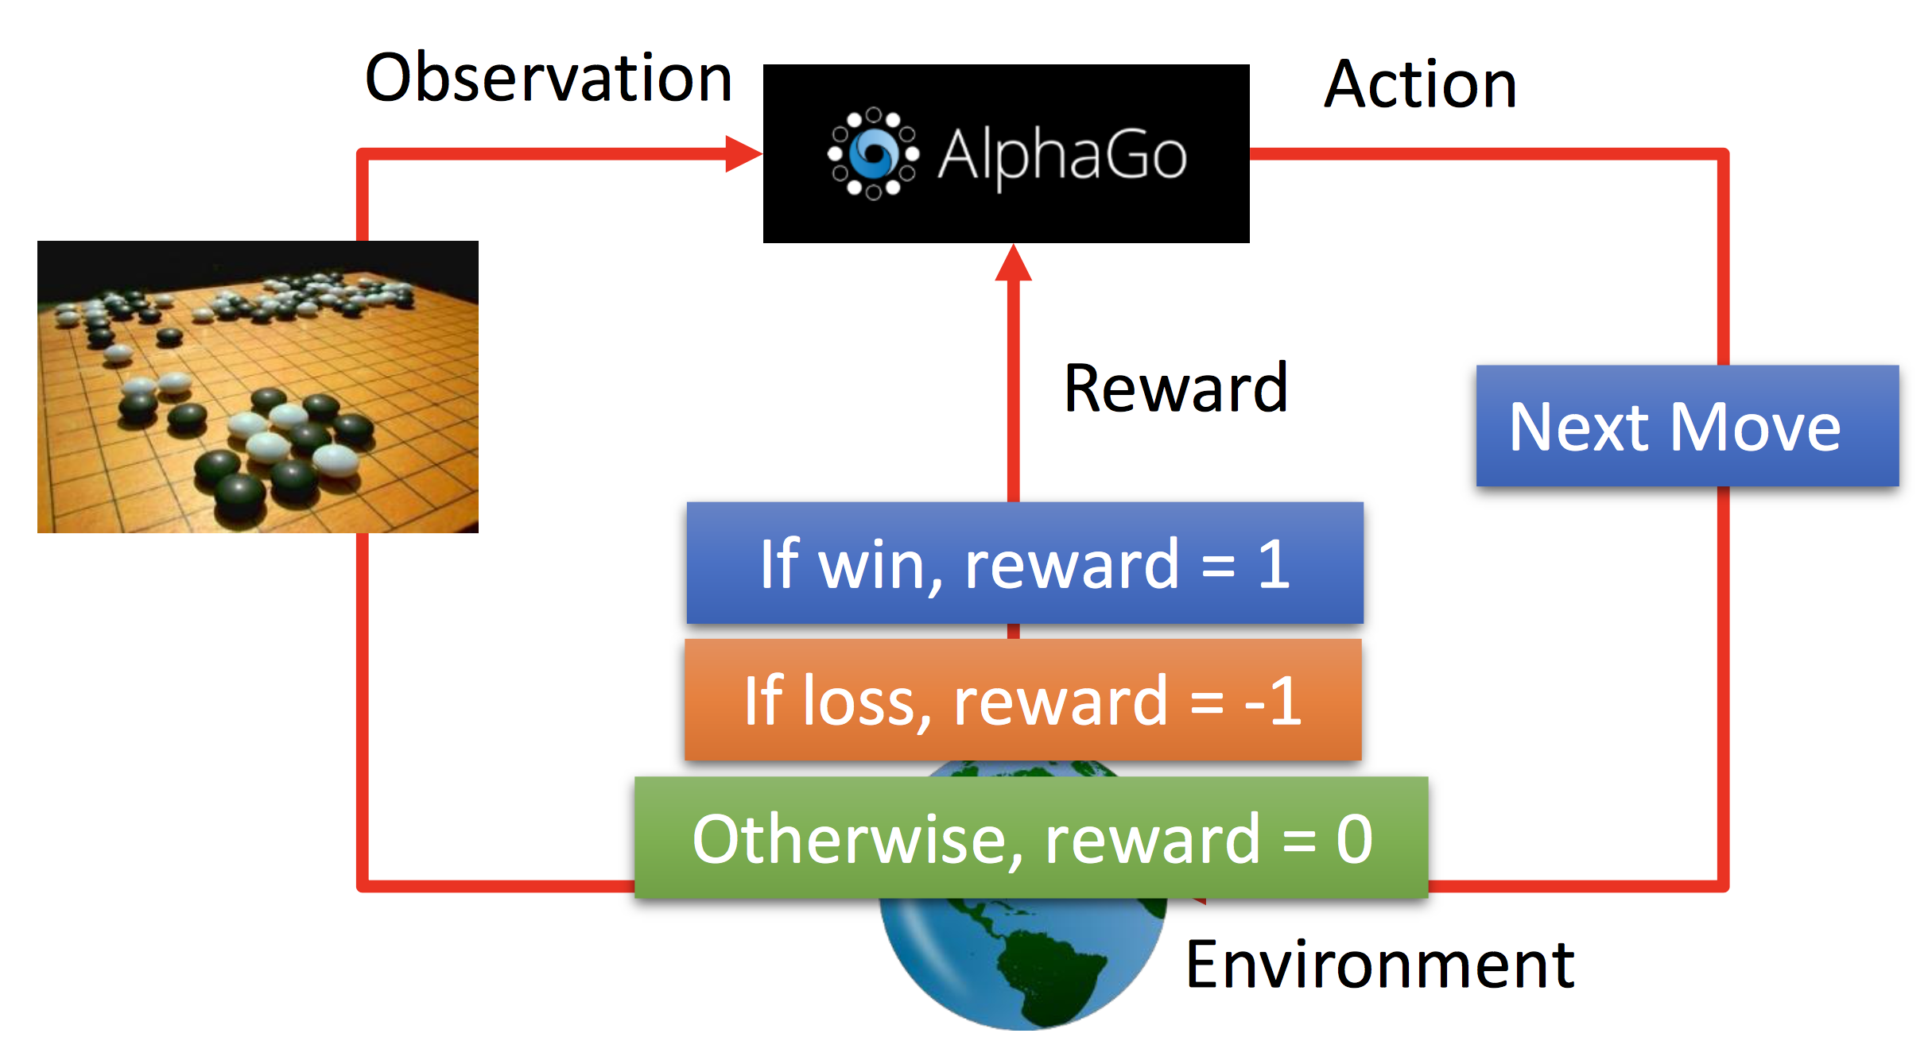
Reinforcement Learning Overview
Choosen by Policy

Slide 22
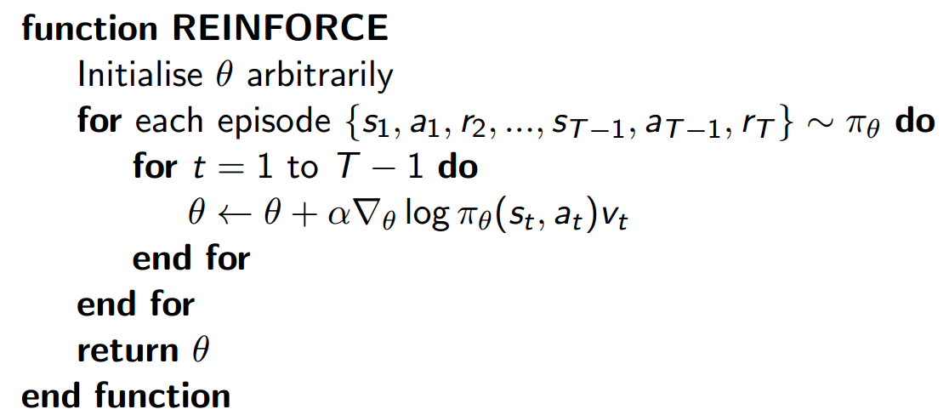
Policy Gradient on Seq2seq
Consider the output of decoder as the policy.
agent : seq2seq model
state : input sentence
action space : vocabulary size
Using Policy Gradient

Slide 23
Overview
reference : David Silver, Policy Gradient
Policy
Gradient
“Today”
“was”
“so”
“awesome”
Reward
sample
sample
sample
(Start)
“Today”
“was”
“so”

Slide 24
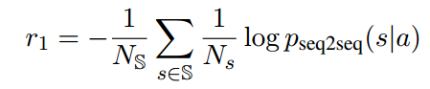
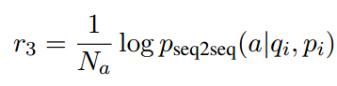
Reward Function
ease of answering
Semantic Coherence
Final reward is the linear combination of the two
reference : Li et al

Slide 25
Training Tips
Find a good baseline:
reduce the variance of the gradient
Pre-train a good seq2seq model first
remove dummy sentences
remove replies that are too short

Slide 26
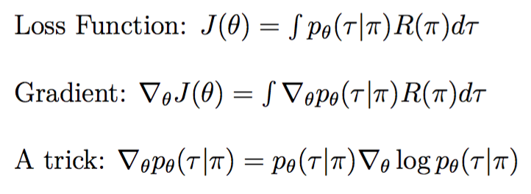
Policy Gradient

Slide 27
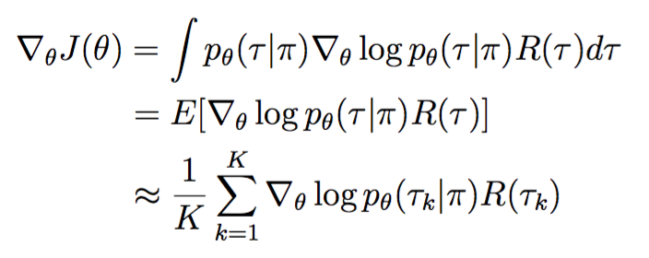
Policy Gradient

Slide 28
Others
Grading policy and Github submission format will be announced next week (5/19).
Write a simple seq2seq and train a basic model if your team have time.

Slide 29
MLDS 2017 Spring
HW4 - Seq2seq & RL
(cont.)
mldsntu2017@gmail.com

Slide 30
Outline
How to choose a reward function
Some other methods for Policy Gradient
Mixed Increment Cross-Entropy REINFORCE
Actor-Critic for Sequence Prediction
Baseline Function
Format & Submission Rules
Notes:
===戴===
Introduction
Seq2seq : S2VT
===施&陳===
Training Tips
===棋&袁===
How to reach the baseline?
Format Submission & Rules = testing時間，兩份run.sh格式 , 評分方式（ranking included）, 互評表單連結,禁止使用pre-trained model
===========
我會負責和各位確認報告內容

Slide 31
Choosing Reward Function
BLEU
CIDEr
Meteor
ROUGEL
Probability of sequence (Li et al.)
some hand-crafted rules

Slide 32
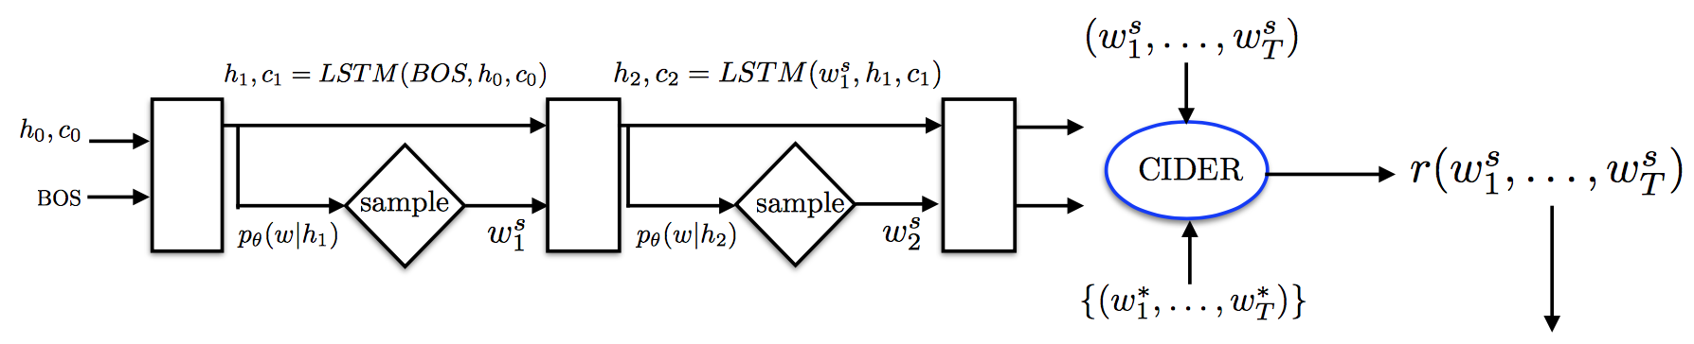
BLEU, CIDEr, Meteor...etc
Final reward is the BLEU score of the sampled sentence
outputs
reference

Slide 33
Probability of sequence (Li et al.)
For example:
Semantic Coherence
Try to preserve grammar strucutre
reference : Li et al

Slide 34
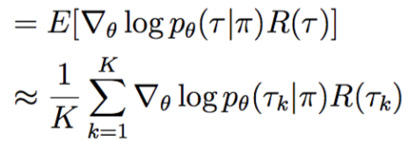
Other Method for Getting Weight of Gradient
Monte Carlo
Monte Carlo search N samples at each time steps to get expected reward
“Today”
“was”
“so”
“awesome”
sample
sample
sample
(Start)
“Today”
“was”
“so”

Slide 35
Other Method for Getting Weight of Gradient
Actor-Critic method
train a neural network that predict expected reward of subsequence
EX: actor-critic for sequence prediection
Hybrid approach
MIXER

Slide 36
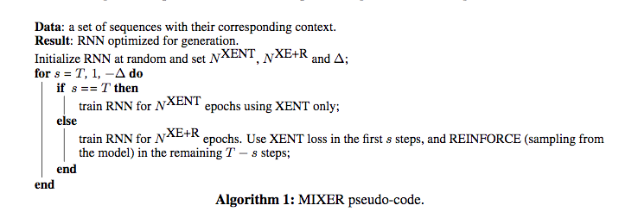
Mixed Incremental Cross-Entropy REINFORCE
MIXER = XENT + REINFORCE with an annealing schedule

Slide 37
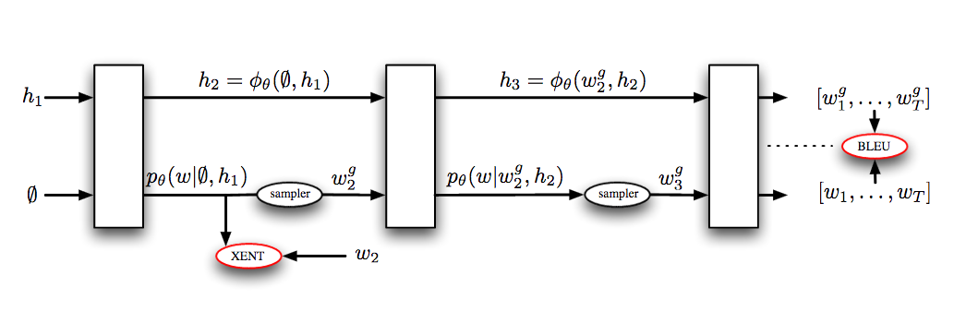
Mixed Incremental Cross-Entropy REINFORCE
MIXER = XENT + REINFORCE with an annealing schedule

Slide 38
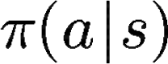
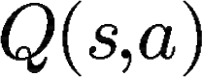
Actor-Critic for Sequence Prediction
state: s
action: a
Actor
policy
Critic
action-value function
Similar to GAN, but not the same
critic compare with discriminator

Slide 39
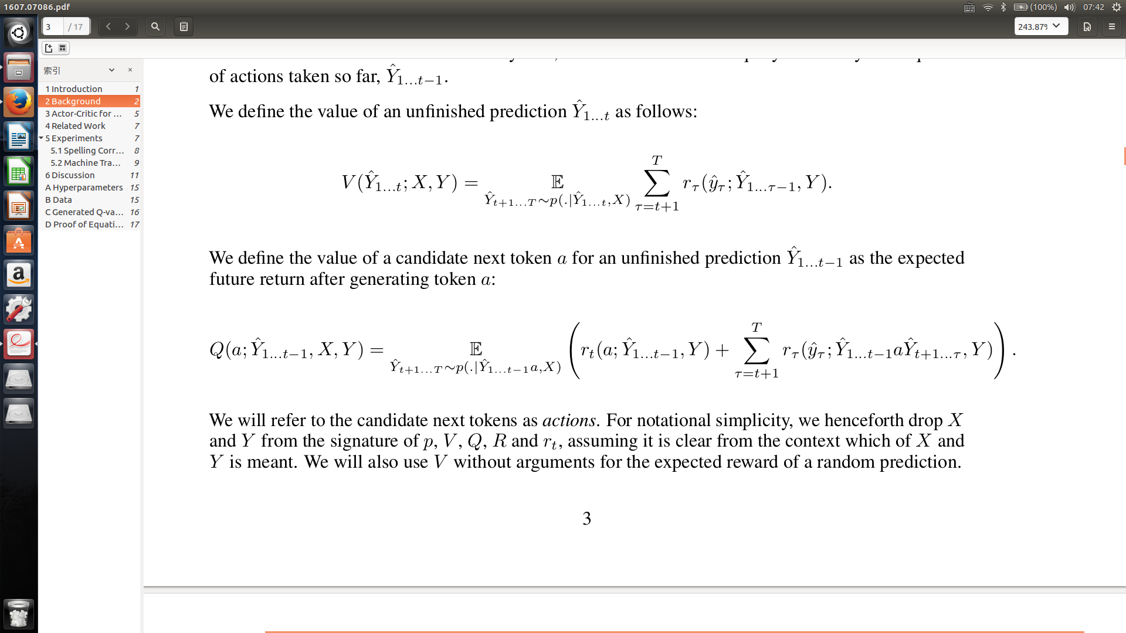
Background
Value function
Policy : conditioned RNN
Return R : task-specific score (e.g., BLEU score)
Return R is partially received in the intermediate steps :

Slide 40
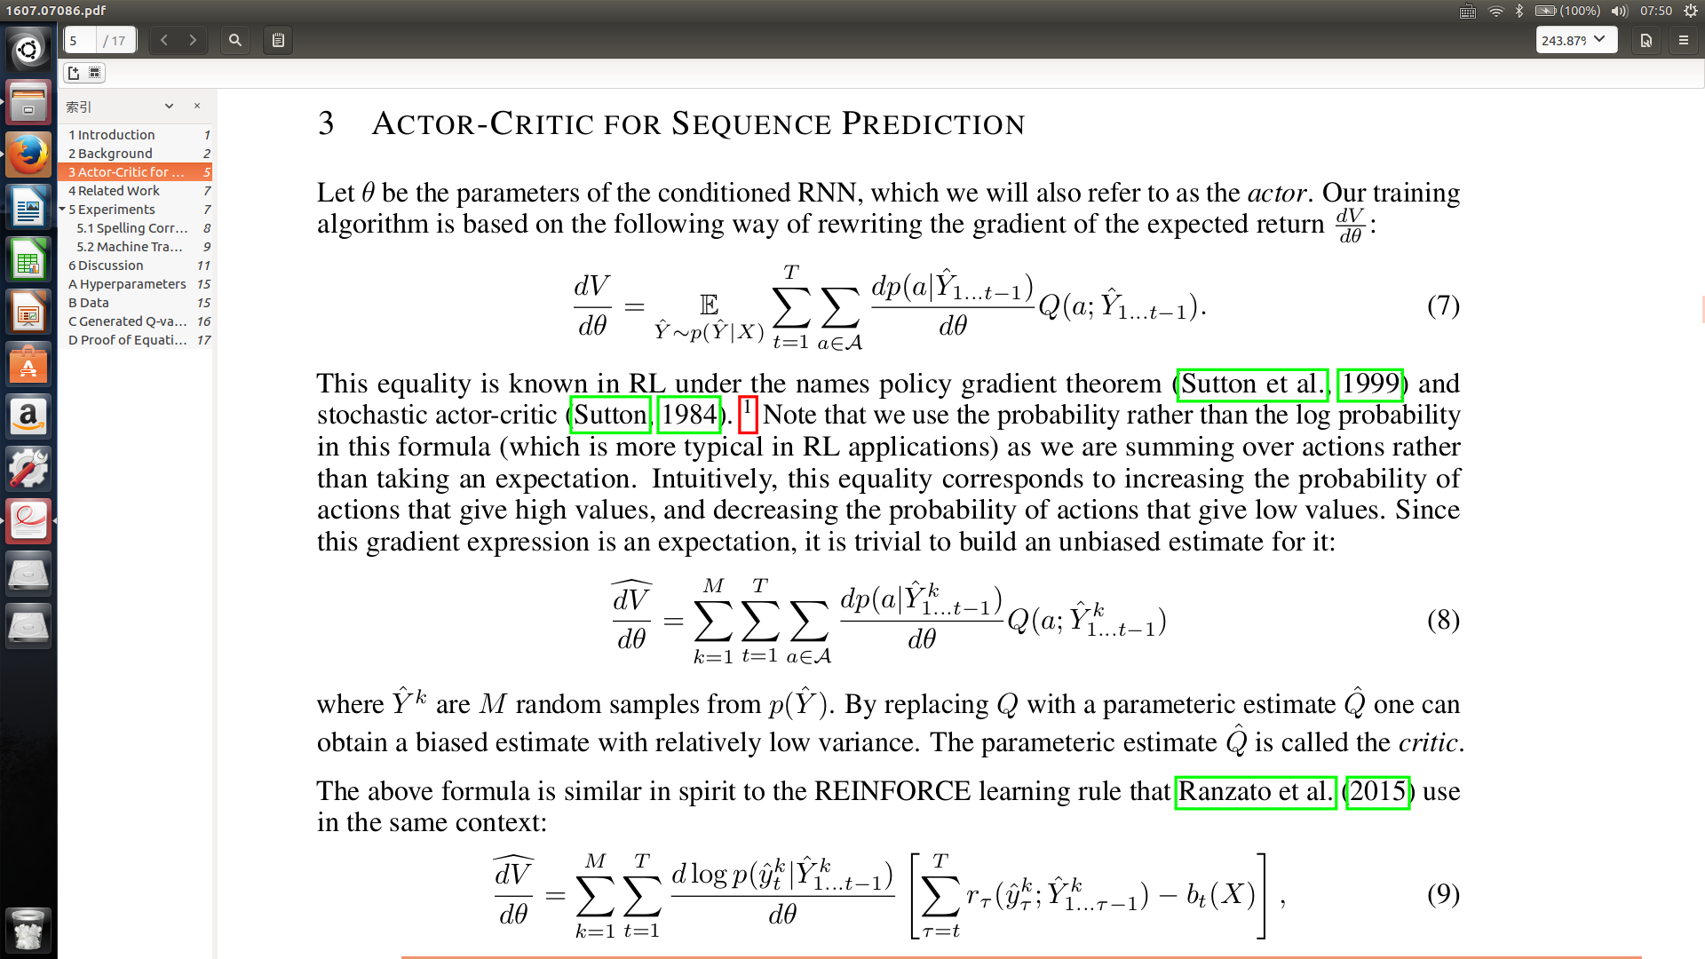
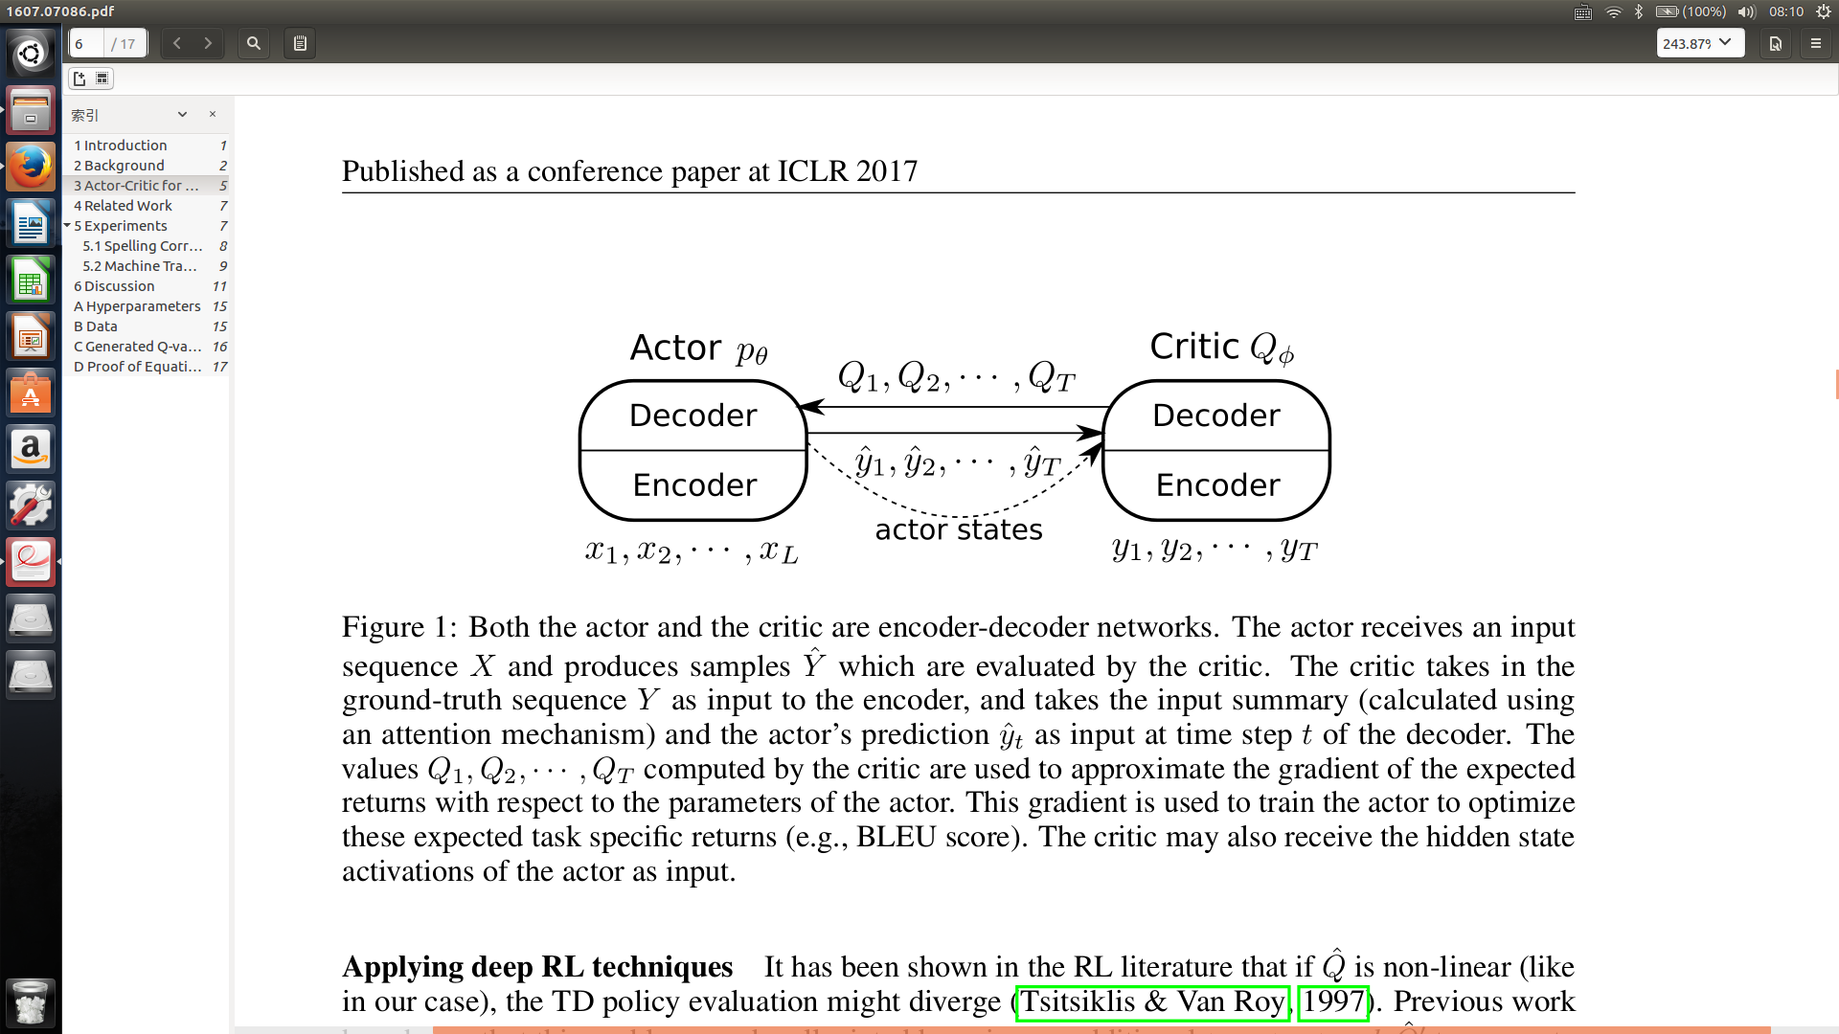
Actor-Critic for Sequence Prediction

Slide 41
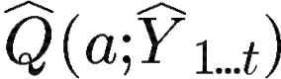
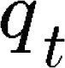
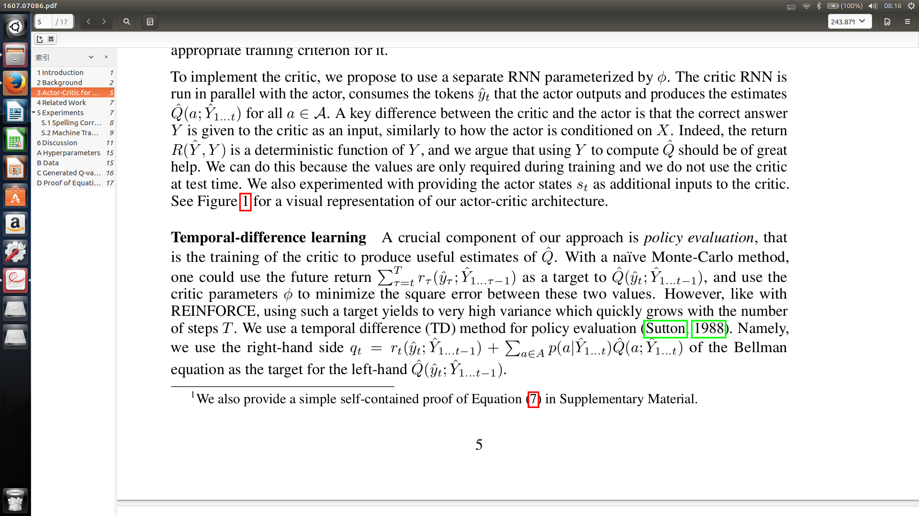
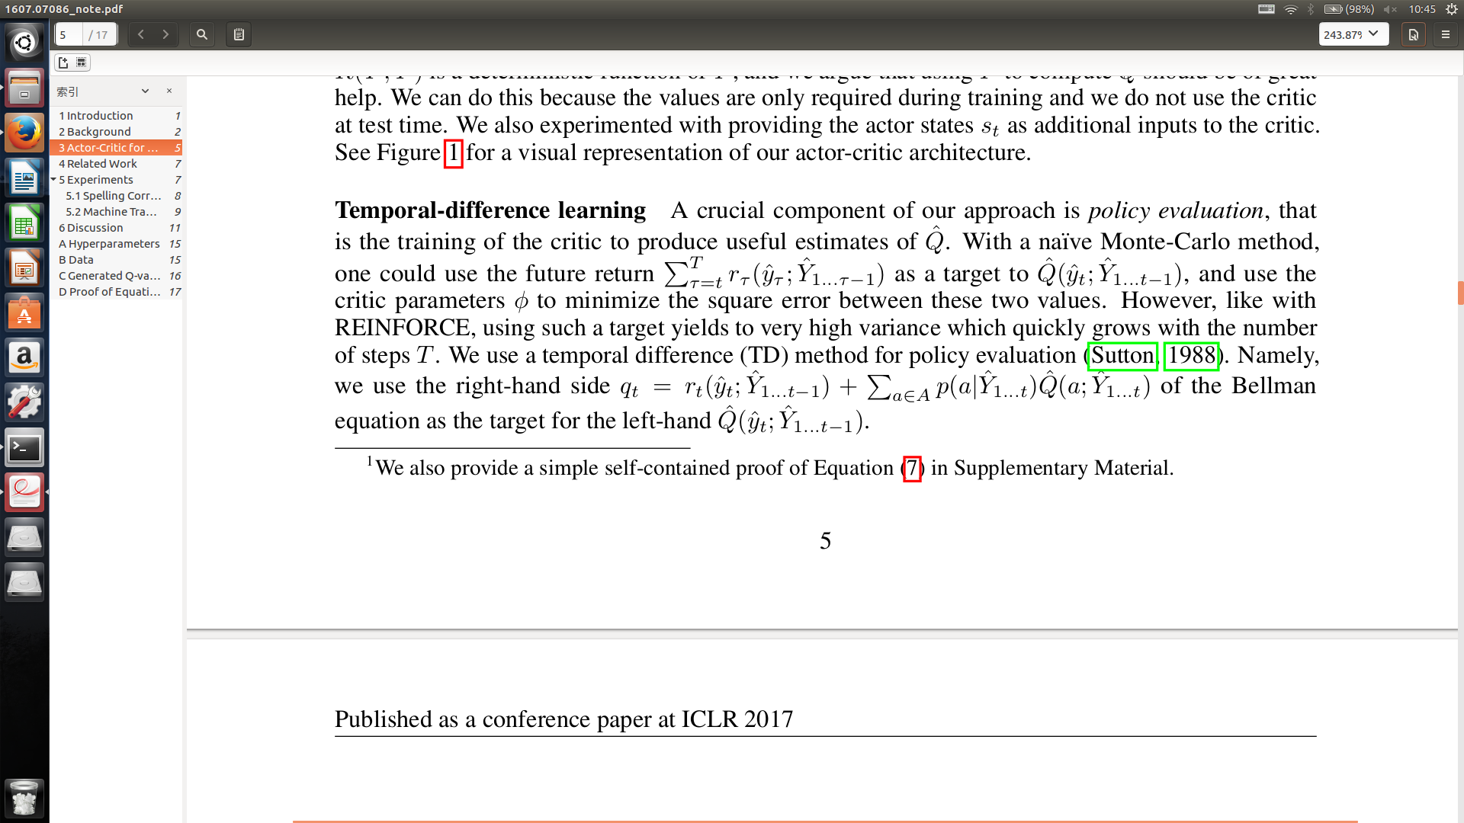
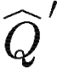
Actor-Critic for Sequence Prediction
critic RNN
Temporal-difference learning
target of critic
compare with Monte-Carlo :
Apply deep RL techniques
target network to estimate
delayed actor
or target critic and target actor in DDPG

Slide 42
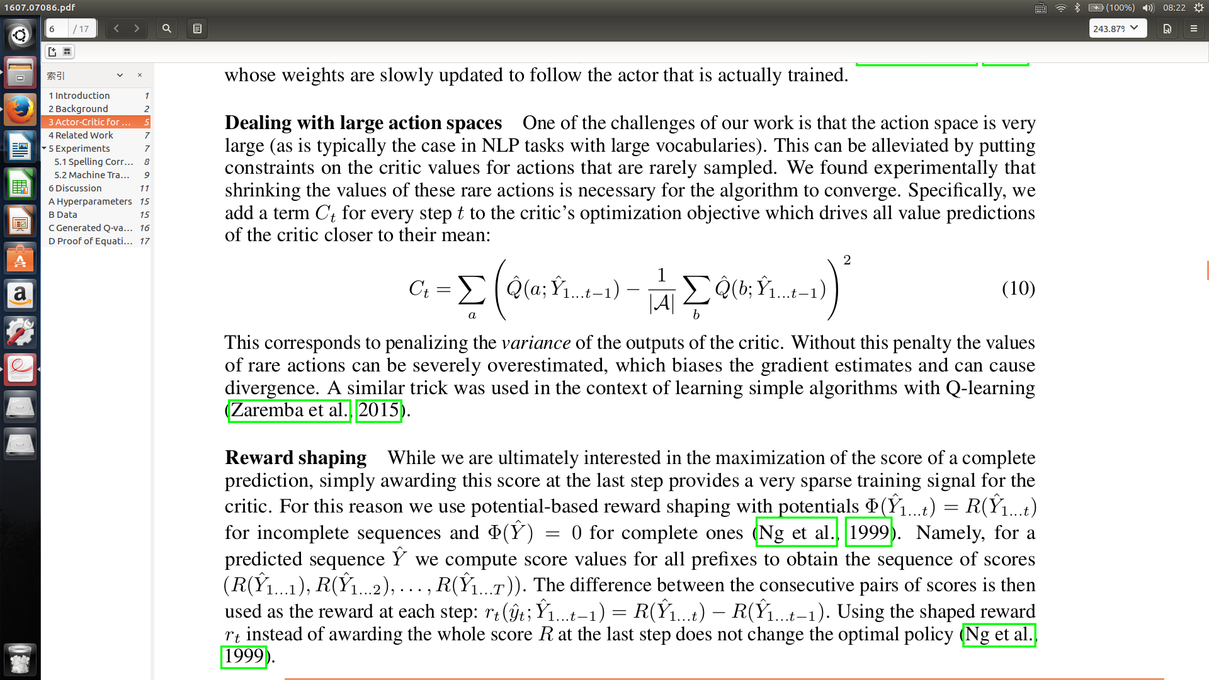
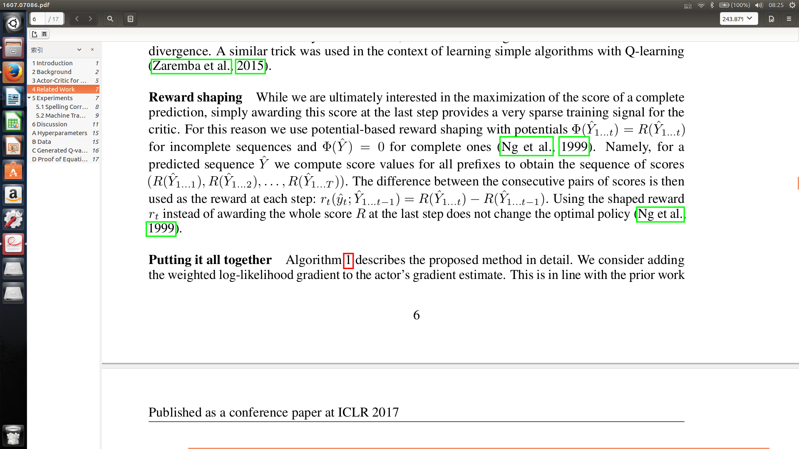

Actor-Critic for Sequence Prediction
Dealing with large action spaces
rare actions can be severely overestimated
penalized term :
Reward shaping
compute score values for all prefixes

Slide 43
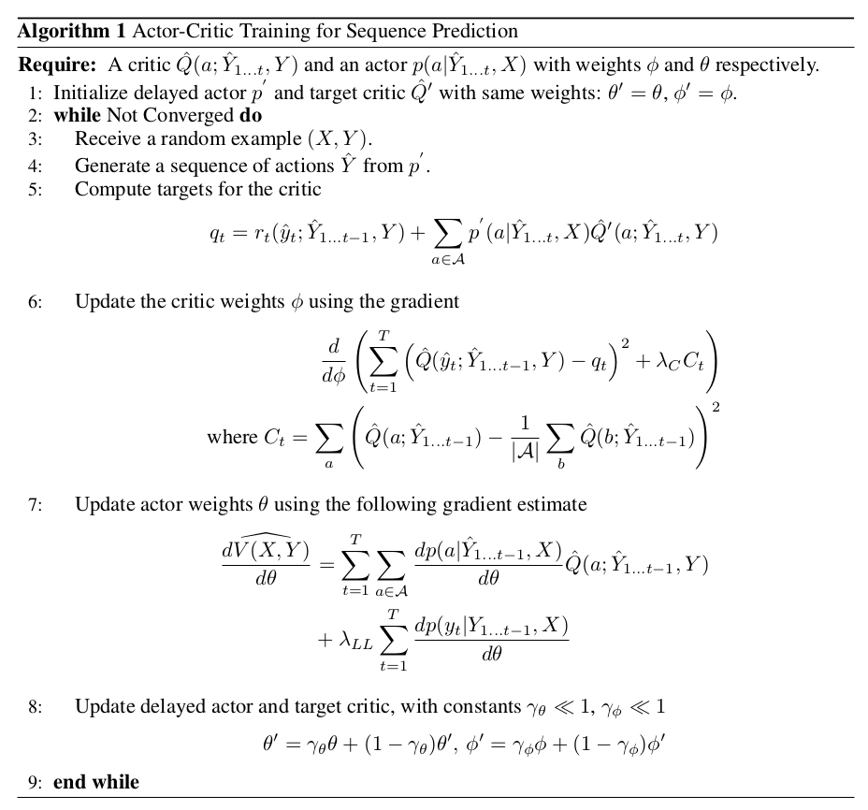

Slide 44
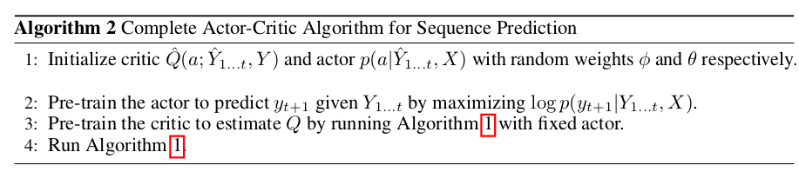
Actor-Critic for Sequence Prediction
Pre-training

Slide 45
Baseline Function
constant
choose a pre-defined scalar
average
the average value of other rewards
argmax
choose b as the reward of sentence generated by argmax of each time step

Slide 46
Submission
Only Python with Tensorflow r1.0
You are allowed to use any tool to process text
You are allowed to use any data you collect
Deadline: 6/8(Thu.) 23:59:59 (UTC+8)
MLDS2017/hw4 should contain following files
run.sh, sample_input.txt, sample_output_[S2S, RL, BEST].txt, report.pdf ...
bash run.sh [S2S, RL, BEST] [INPUT_FILE] [OUTPUT_FILE]
TAs will run your run.sh to generate responses
run.sh must output in 10 minutes.

Slide 47
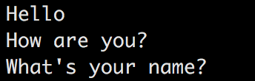
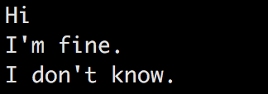
Submission(.txt)
Each line contains a sentence

Slide 48
What report should cover?
Environment & data sets (1%)
Ex. OS, CPU, GPU, Memory, libraries you used and version, etc.
Model description & reward functions (2%)
How do you improve your performance (3%)
Experiment settings and observation (3%)
Team division (1%)
No more than 4 pages
Please written in Chinese (unless you don’t know how to type Chinese)

Slide 49
Grading Policy (20%)
Format 1%
Code 4% (S2S 2% + RL 2%)
Report 10%
各組互評 5%
Bonus
互評前三名 (5% 3% 1%)
You have to present how you beat other teams to get bonus.

Slide 50
Other Policy
Late policy: 30% off per day late afterwards. [Delay form will be announced afterwards]
No plagiarism is allowed.

Slide 51
Q&A
Q: sample testing data要自己提供嗎? 形式呢? A: 是的，就跟投影片上的一樣，大約5~10句。

